Slide 1
BBEACONS
Thomas Van Raemdonck & Wouter Vande Velde
Notes:
wouter

Slide 2
Table of contents
BBeacons
Bluetooth beacons
Trilateration
Mobile Application
Website
Database
Demo
Notes:
wouter

Slide 3
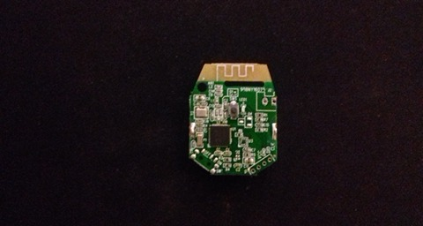
BBeacons
Indoor location
Bluetooth beacons
Website
Database
Mobile Application
Notes:
Thomas

Slide 4
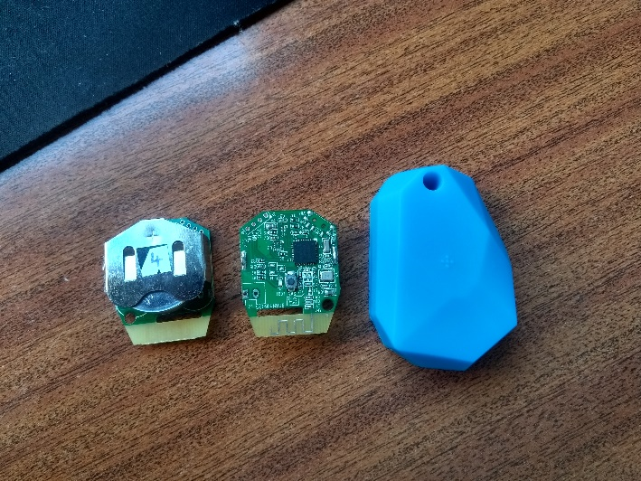
Bluetooth beacons
Wellcore
NRF51822
China
Cheaper
Inaccurate values

Slide 5
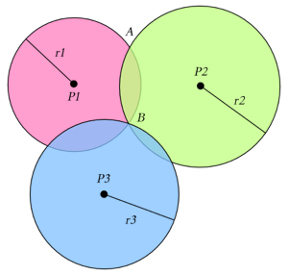
Trilateration
3 points
Circles
RSSI-values
Distances
Intersection point
Notes:
thomas

Slide 6
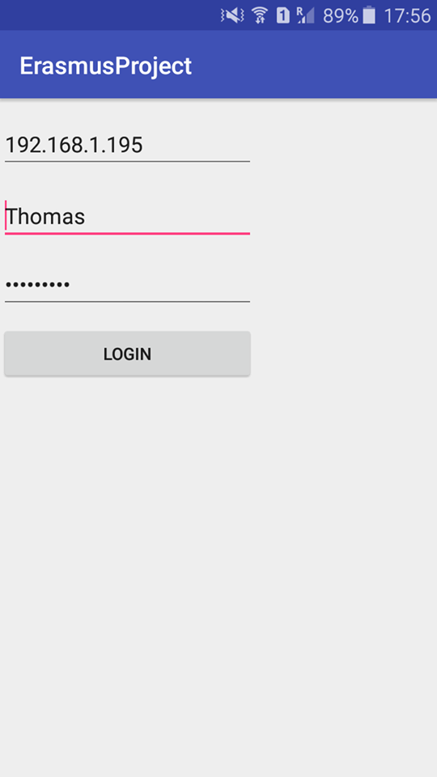
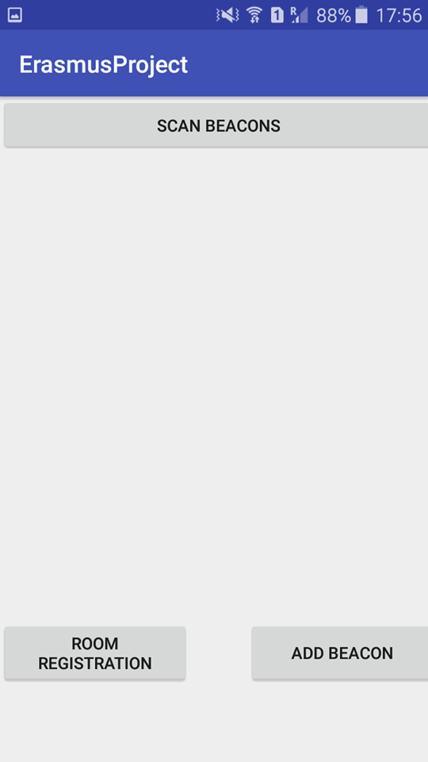
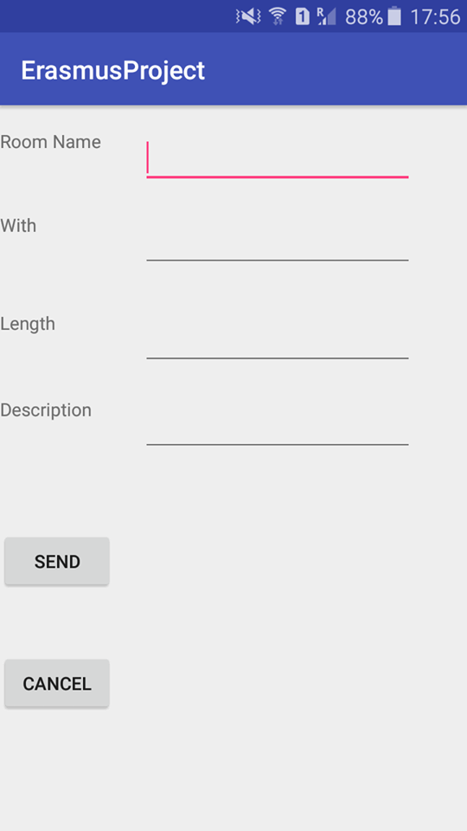
Mobile Application
Android Studio
Login
Add beacon
Add room
Scanning beacons
Heatmap
Notes:
Thomas

Slide 7
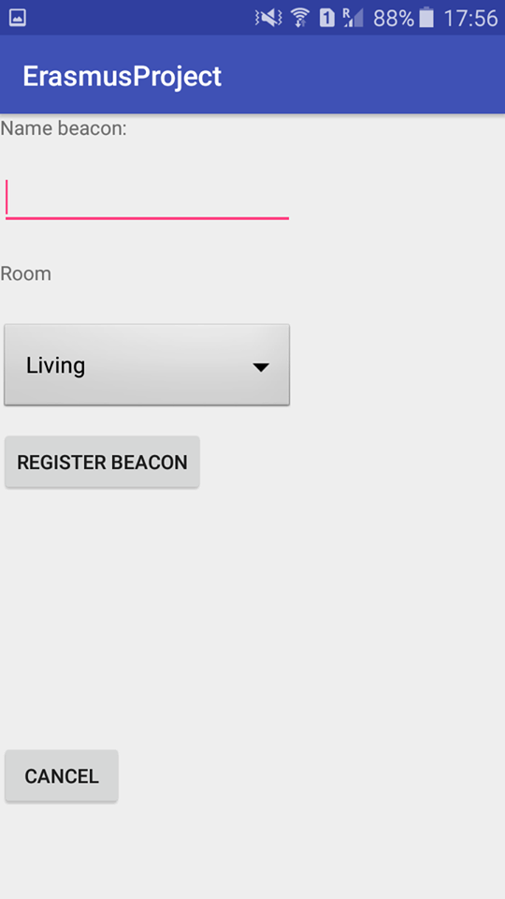
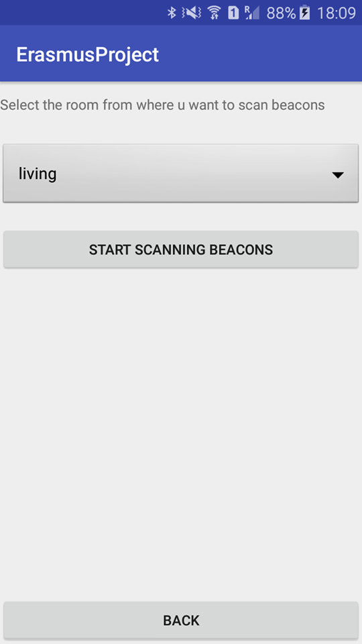
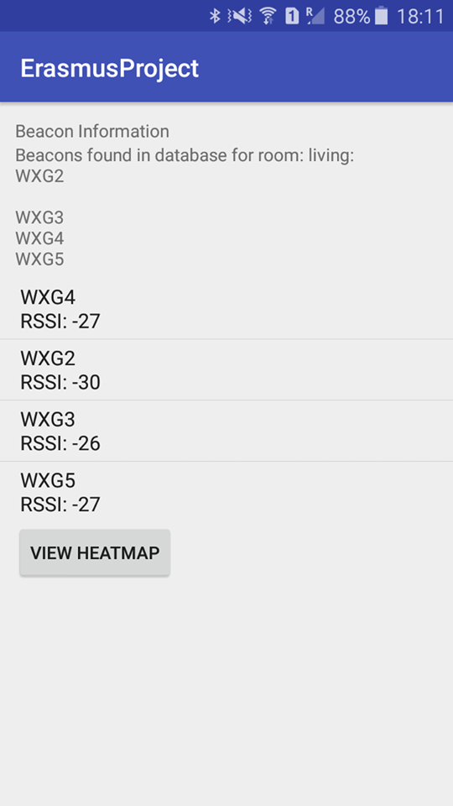
Mobile Application
Notes:
thomas

Slide 8
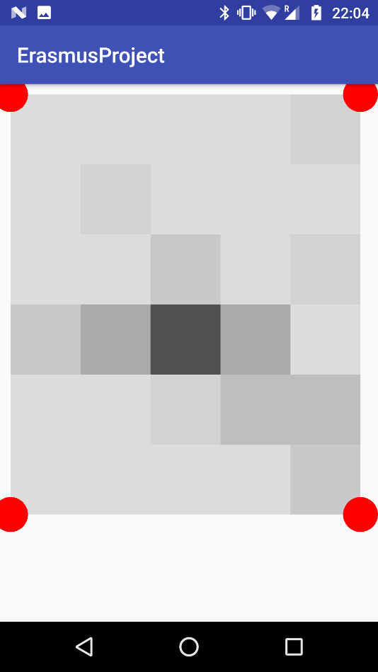
Mobile application
Heatmap
Adjustable to size of room

Slide 9
Website
2 pages
Laravel
Php artisan serve
Localhost
Eloquent ORM

Slide 10
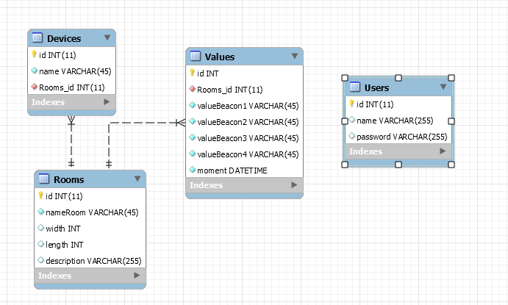
Database
Mysql
Local server
phpmyadmin
User table -> connection
Notes:
thomas

Slide 11
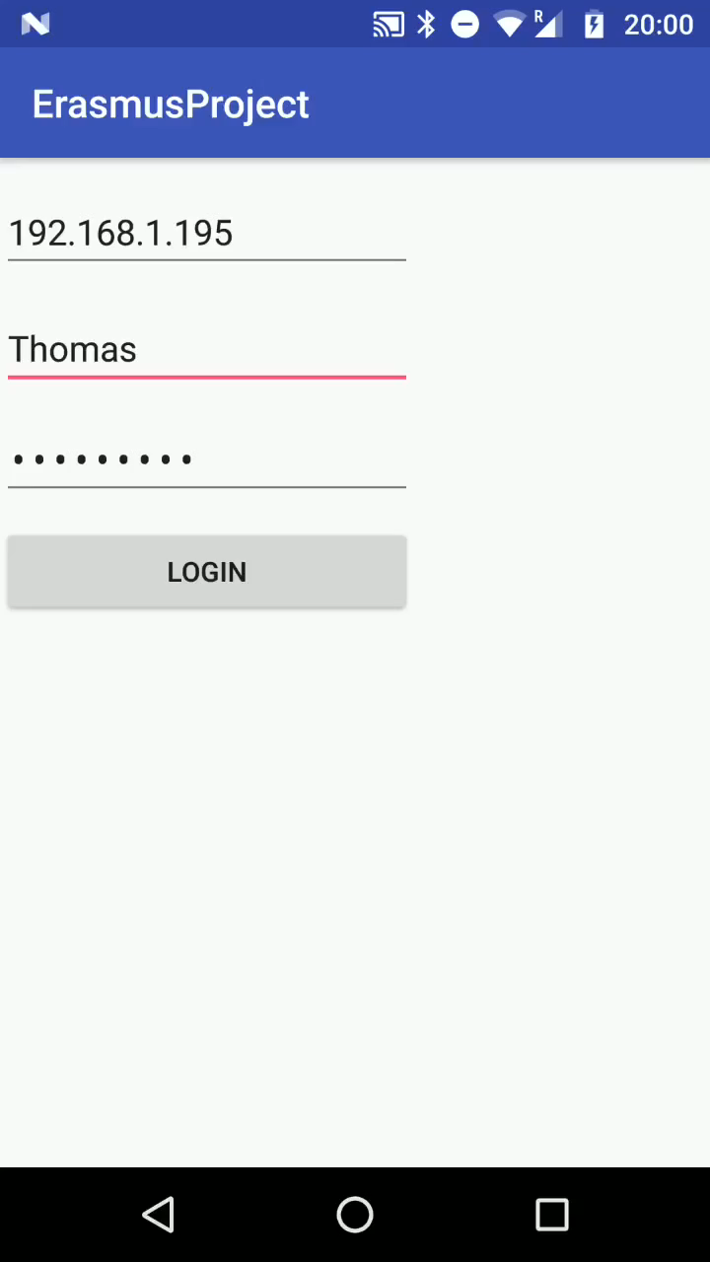
Demo
Notes:
thomas

Slide 12
The end
Questions?
Notes:
wouter

